Slide 1
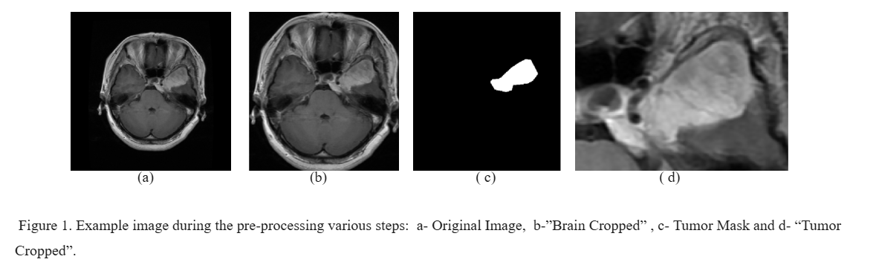
Brain Tumor Classification and Segmentation with DINOv2
Fine-Tuning Unsupervised Feature Extractor on MRI Scans
Hod Fluger, 2025

Slide 2
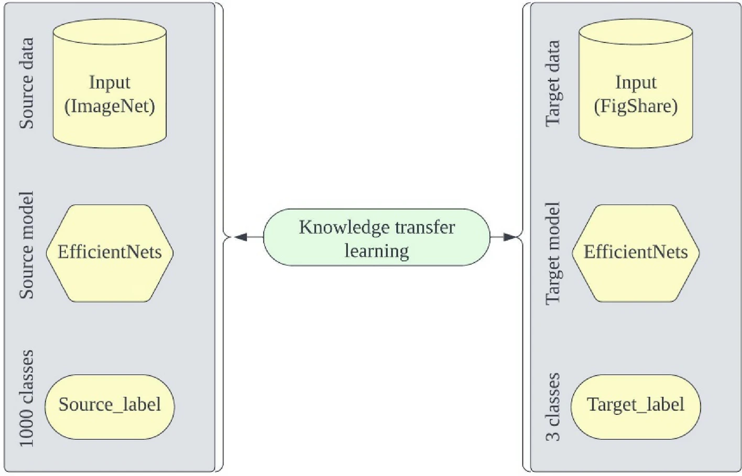
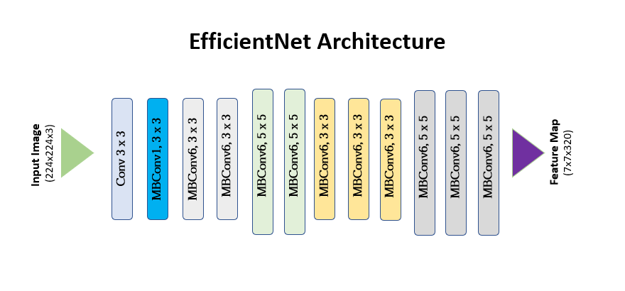
Original Paper
“Detection and classification of brain tumor using hybrid deep learning models”
Vimala, Srinivasan, Mathivanan, Mahalakshmi, Jayagopal (2023)
Used transfer learning with
pre trained EfficientNet (CNN) as a backbone.

Slide 3
My Problem
Classifying Brain Tumors to 3 types: meningioma, glioma, pituitary.
Segmenting the tumors - my addition.
Data - “FigShare”: 3064 Brain MRI scans (from 233 patienes).

Slide 4
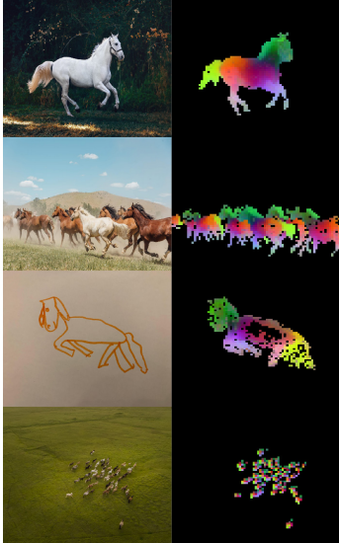
My Backbone - DINOv2
State-of-the-art self-supervised vision transformer model.
Released by Meta AI in 2024.
Learns powerful visual representations without relying
on labeled data.
Trained on a massive dataset of unlabeled images.
(142M), enabling it to learn very general visual features.
The learned features can be used for a wide range of down
vision tasks (classification, object detection, semantic
segmentation, depth estimation, etc).

Slide 5
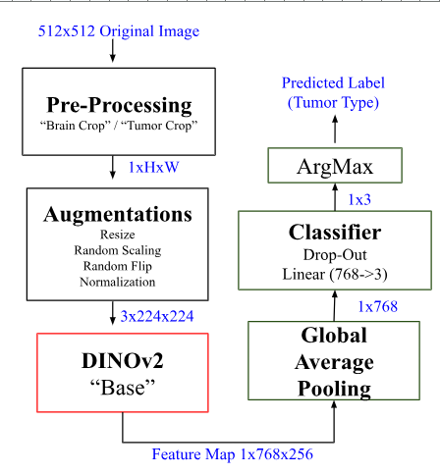
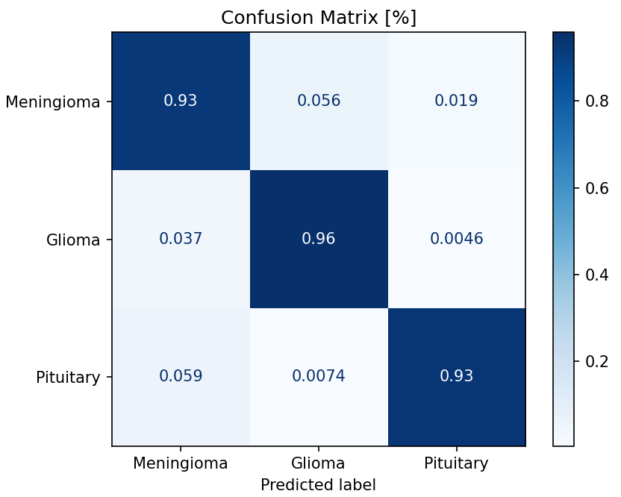
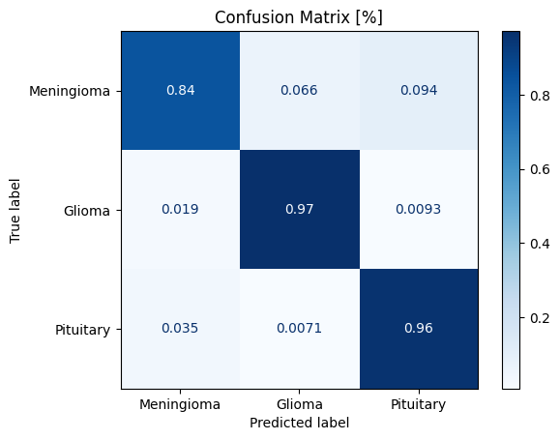
Classification - Solution
Validation
Test
Loss Function: Focal Loss (“Balanced” CE)
Augmentations: Tumor Crop, Flip, Scale, Normalize.

Slide 6
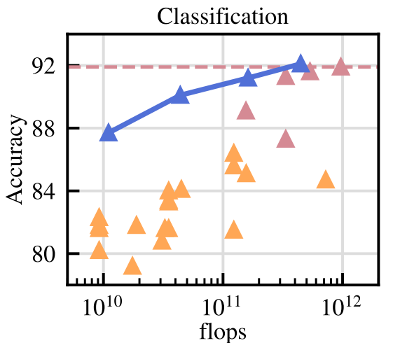
Classification - Benchmark
My Results
94
Weakly-Supervised Models
Self-Supervised Models
Fine-tuned DINOv2
(average of 12 benchmarks)

Slide 7
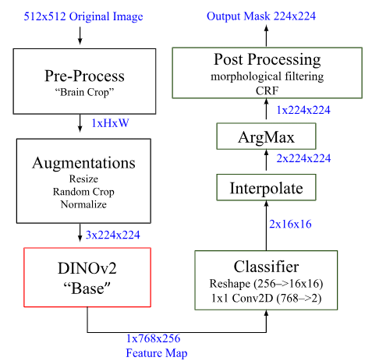
Semantic Segmentation - Solution
Combined Loss Function:
Dice Loss + Cross Entropy
Post Process: morphological, CRF.

Slide 8
Semantic Segmentation - Results
Metric / Segmentation Predictions | Validation mIoU [%] | Test mIoU [%] | Validation F1 Score [%] | Test F1 Score [%]
Original Model Tumor Predictions (Th=0.5) | 48.6 | 47.6 | 61.7 | 59.9
Original Model + Post Processing (Morphological Filtering + CRF) | 52.4 | 51.4 | 63.3 | 61.9
Lowering Tumor Prediction Threshold (to 0.17) +Post Processing (Morphological Filtering + CRF) | 54.4 | 52.8 | 65.9 | 63.9
Most self-supervised models achieve mIoU of 50%-60% in semantic segmentation tasks.

Slide 9
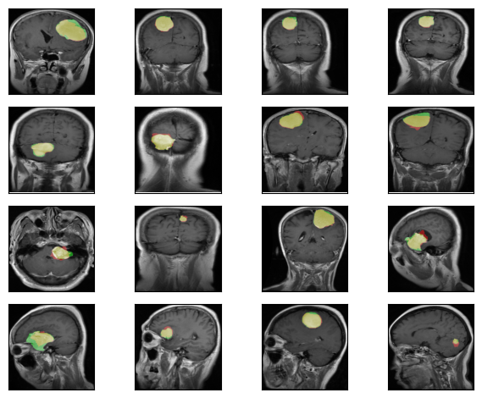
Semantic Segmentation - Visuals
Prediction Ground Truth True Positive

Slide 10
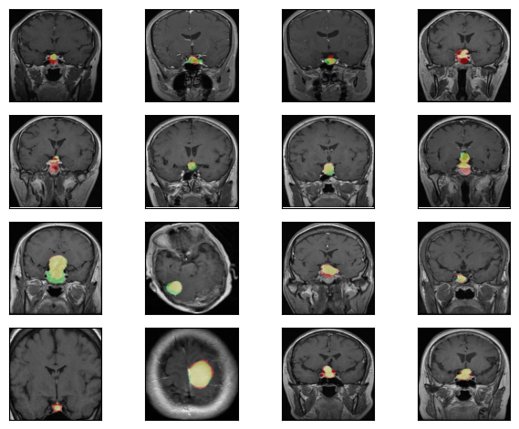
Semantic Segmentation - Visuals
Prediction Ground Truth True Positive

Slide 11
Thank You!

